Slide 1
Synthesizing and Repairing Expressions using Types and Weights
Tihomir Gvero, Viktor Kuncak, Ivan Kuraj and Ruzica Piskac

Slide 2
Motivation
Large APIs and libraries
$\sim 4000$ classes in Java 6.0 standard library
Using those APIs (for the first time) can be
Tedious
Time consuming
Developers should focus on solving creative tasks
Manual Solution
Read Documentation
Inspect Examples
Automation = Code synthesis + Code completion
Notes:
Better to say: “Developer develop applications”
Do not say: “This is (the main) problem”, this can be “obstacle” because while programming there are many more important (harder) task. Do not say “this is hard”, it is an “obstacle”, “barrier”.

Slide 3
Our Solution
InSynth: Interactive Synthesis of Code Snippets
Input:
Scala partial program
Cursor point
We automatically extract:
Declarations in scope (with/without statistics from corpus)
Desired type
Algorithm
Complete
Efficient – output N expressions in less than T ms
Effective – favor useful expressions over obscure ones
Generates expressions with higher order functions
Output
Ranked list of expressions
Notes:
Important:
1. Unlike Mira we recommend expressions, not declarations.
1. Unlike Tao and Yahav, we synthesize snippets using all visible methods in a context,
whereas the other existing tools build or present them only if they
exist in a corpus (In short, we can synthesis expressions with/without statistics from the corpus
2. incorporate the extracted examples into the current program context;
this requires additional effort on the part of the programmer.
3. Unlike Gulwani we generate complete expressions based only on
the type constraints. In addition, our approach also supports higher
order functions, and the returned code snippets can be arbitrarily
nested and complex: there is no bound on the number and depth of
arguments. This allows us to automatically synthesize larger pieces
of code in practice, as our evaluation shows. In that sense, our result
is a step further from simple completion to synthesis.

Slide 4
Sequence of Streams
def main(args:Array[String]) = {
var body:String = "email.txt"
var sig:String = "signature.txt"
var inStream:SeqInStr =
…
}
Notes:
It adapt to some code base, the declarations that are more used will appear more often in the suggestions.
- Full expressions, not only a single method.
Synthesizing expressions that haven’t seen before anywhere, and are still likely to appear.

Slide 5
Sequence of Streams
def main(args:Array[String]) = {
var body:String = "email.txt"
var sig:String = "signature.txt"
var inStream:SeqInStr =
…
}
new SeqInStr(new FileInStr(sig), new FileInStr(sig))
new SeqInStr(new FileInStr(sig), new FileInStr(body))
new SeqInStr(new FileInStr(body), new FileInStr(sig))
new SeqInStr(new FileInStr(body), new FileInStr(body))
new SeqInStr(new FileInStr(sig), System.in)
Notes:
It adapt to some code base, the declarations that are more used will appear more often in the suggestions.
- Full expressions, not only a single method.
Synthesizing expressions that haven’t seen before anywhere, and are still likely to appear.

Slide 6
Sequence of Streams
def main(args:Array[String]) = {
var body:String = "email.txt"
var sig:String = "signature.txt"
var inStream:SeqInStr =
…
}
new SeqInStr(new FileInStr(sig), new FileInStr(sig))
new SeqInStr(new FileInStr(sig), new FileInStr(body))
new SeqInStr(new FileInStr(body), new FileInStr(sig))
new SeqInStr(new FileInStr(body), new FileInStr(body))
new SeqInStr(new FileInStr(sig), System.in)
Notes:
It adapt to some code base, the declarations that are more used will appear more often in the suggestions.
- Full expressions, not only a single method.
Synthesizing expressions that haven’t seen before anywhere, and are still likely to appear.

Slide 7
Sequence of Streams
def main(args:Array[String]) = {
var body:String = "email.txt"
var sig:String = "signature.txt"
var inStream:SeqInStr = new SeqInStr(new FileInStr(sig), new FileInStr(body))
…
}
Notes:
It adapt to some code base, the declarations that are more used will appear more often in the suggestions.
- Full expressions, not only a single method.
Synthesizing expressions that haven’t seen before anywhere, and are still likely to appear.

Slide 8
Sequence of Streams
def main(args:Array[String]) = {
var body:String = "email.txt"
var sig:String = "signature.txt"
var inStream:SeqInStr = new SeqInStr(new FileInStr(sig), new FileInStr(body))
…
}
Imported over 3300 declarations
Executed in less than 250ms
Notes:
It adapt to some code base, the declarations that are more used will appear more often in the suggestions.
- Full expressions, not only a single method.
Synthesizing expressions that haven’t seen before anywhere, and are still likely to appear.

Slide 9
TreeFilter (HOF)
def filter(p: Tree => Boolean): List[Tree] = {
val ft:FilterTreeTraverser =
ft.traverse(tree)
ft.hits.toList
}
Notes:
It adapt to some code base, the declarations that are more used will appear more often in the suggestions.
new FilterTypeTreeTraverser(var_1 => p(var_1))
new FilterTypeTreeTraverser(var_2 => isType)
new FilterTypeTreeTraverser(var_1 => p(tree))
new FilterTypeTreeTraverser(var_2 => new TreeWrapper(var_2).isType)
new FilterTypeTreeTraverser(var_1 => p(new TreeWrapper(var_1).tree))

Slide 10
TreeFilter (HOF)
def filter(p: Tree => Boolean): List[Tree] = {
val ft:FilterTreeTraverser =
ft.traverse(tree)
ft.hits.toList
}
new FilterTreeTraverser(x => p(x))
new FilterTreeTraverser(x => isType)
new FilterTreeTraverser(x => p(tree))
new FilterTreeTraverser(x => new Wrapper(x).isType)
new FilterTreeTraverser(x => p(new Wrapper(x).tree))
Notes:
It adapt to some code base, the declarations that are more used will appear more often in the suggestions.
new FilterTypeTreeTraverser(var_1 => p(var_1))
new FilterTypeTreeTraverser(var_2 => isType)
new FilterTypeTreeTraverser(var_1 => p(tree))
new FilterTypeTreeTraverser(var_2 => new TreeWrapper(var_2).isType)
new FilterTypeTreeTraverser(var_1 => p(new TreeWrapper(var_1).tree))

Slide 11
TreeFilter (HOF)
def filter(p: Tree => Boolean): List[Tree] = {
val ft:FilterTreeTraverser =
ft.traverse(tree)
ft.hits.toList
}
new FilterTreeTraverser(x => p(x))
new FilterTreeTraverser(x => isType)
new FilterTreeTraverser(x => p(tree))
new FilterTreeTraverser(x => new Wrapper(x).isType)
new FilterTreeTraverser(x => p(new Wrapper(x).tree))
Notes:
It adapt to some code base, the declarations that are more used will appear more often in the suggestions.
new FilterTypeTreeTraverser(var_1 => p(var_1))
new FilterTypeTreeTraverser(var_2 => isType)
new FilterTypeTreeTraverser(var_1 => p(tree))
new FilterTypeTreeTraverser(var_2 => new TreeWrapper(var_2).isType)
new FilterTypeTreeTraverser(var_1 => p(new TreeWrapper(var_1).tree))

Slide 12
TreeFilter (HOF)
def filter(p: Tree => Boolean): List[Tree] = {
val ft:FilterTreeTraverser = new FilterTreeTraverser(x => p(x))
ft.traverse(tree)
ft.hits.toList
}
Notes:
It adapt to some code base, the declarations that are more used will appear more often in the suggestions.
new FilterTypeTreeTraverser(var_1 => p(var_1))
new FilterTypeTreeTraverser(var_2 => isType)
new FilterTypeTreeTraverser(var_1 => p(tree))
new FilterTypeTreeTraverser(var_2 => new TreeWrapper(var_2).isType)
new FilterTypeTreeTraverser(var_1 => p(new TreeWrapper(var_1).tree))

Slide 13
TreeFilter (HOF)
def filter(p: Tree => Boolean): List[Tree] = {
val ft:FilterTreeTraverser = new FilterTreeTraverser(x => p(x))
ft.traverse(tree)
ft.hits.toList
}
Imported over 4000 declarations
Executed in less than 300ms
Notes:
It adapt to some code base, the declarations that are more used will appear more often in the suggestions.
new FilterTypeTreeTraverser(var_1 => p(var_1))
new FilterTypeTreeTraverser(var_2 => isType)
new FilterTypeTreeTraverser(var_1 => p(tree))
new FilterTypeTreeTraverser(var_2 => new TreeWrapper(var_2).isType)
new FilterTypeTreeTraverser(var_1 => p(new TreeWrapper(var_1).tree))

Slide 14
COMPLETION = INHABITATION
Notes:
State what inhabitation is. Everything else seams to be on the slide.

Slide 15
COMPLETION = INHABITATION
def m1: T1
…
def mn: Tn
val a: T = ?
Notes:
Put beneath “val a : T = …” = “\Gamma \vdash ?:\tau”
Later we want to refine this with: “Efficient Complete Competition could be done using Inhabitation for Succinct Types”

Slide 16
COMPLETION = INHABITATION
def m1: T1
…
def mn: Tn
={ m1: T1,…, mn: Tn}
val a: T = ?
Notes:
Put beneath “val a : T = …” = “\Gamma \vdash ?:\tau”
Later we want to refine this with: “Efficient Complete Competition could be done using Inhabitation for Succinct Types”

Slide 17
COMPLETION = INHABITATION
ENVIRONMENT
def m1: T1
…
def mn: Tn
={ m1: T1,…, mn: Tn}
val a: T = ?
Notes:
Put beneath “val a : T = …” = “\Gamma \vdash ?:\tau”
Later we want to refine this with: “Efficient Complete Competition could be done using Inhabitation for Succinct Types”

Slide 18
COMPLETION = INHABITATION
ENVIRONMENT
def m1: T1
…
def mn: Tn
={ m1: T1,…, mn: Tn}
val a: T = ?
Γ ⊢ ? : T
Notes:
Put beneath “val a : T = …” = “\Gamma \vdash ?:\tau”
Later we want to refine this with: “Efficient Complete Competition could be done using Inhabitation for Succinct Types”

Slide 19
COMPLETION = INHABITATION
ENVIRONMENT
def m1: T1
…
def mn: Tn
={ m1: T1,…, mn: Tn}
val a: T = ?
Γ ⊢ ? : T
DESIRED TYPE
Notes:
Put beneath “val a : T = …” = “\Gamma \vdash ?:\tau”
Later we want to refine this with: “Efficient Complete Competition could be done using Inhabitation for Succinct Types”

Slide 20
Simply Typed Lambda Calculus
x : T ∈ Γ
AX
Γ ⊢ x : T
Γ, x : T₁ ⊢ t : T
ABS
Γ ⊢ λx.t : T₁ → T
Γ ⊢ e₁ : T₁→T Γ ⊢ e₂ : T₁
APP
Γ ⊢ e₁(e₂) : T

Slide 21
Simply Typed Lambda Calculus
Notes:
It might be better to demonstrate that T1 can be any types!
T1 is can be any of infinitely many types, and that is why this is undecidable if we use classic rules.
No bound unless a user provides one.

Slide 22
Simply Typed Lambda Calculus
Γ ⊢ ? : T
Notes:
It might be better to demonstrate that T1 can be any types!
T1 is can be any of infinitely many types, and that is why this is undecidable if we use classic rules.
No bound unless a user provides one.

Slide 23
Simply Typed Lambda Calculus
Backward Search
Γ ⊢ ? : T
Notes:
It might be better to demonstrate that T1 can be any types!
T1 is can be any of infinitely many types, and that is why this is undecidable if we use classic rules.
No bound unless a user provides one.

Slide 24
Simply Typed Lambda Calculus
Γ ⊢ ? : T₁→T
Γ ⊢ ? : T₁
APP
Γ ⊢ ? : T
Notes:
It might be better to demonstrate that T1 can be any types!
T1 is can be any of infinitely many types, and that is why this is undecidable if we use classic rules.
No bound unless a user provides one.

Slide 25
Simply Typed Lambda Calculus
Γ ⊢ ? : T₁→T
Γ ⊢ ? : T₁
APP
Γ ⊢ ? : T
Infinitely many
Notes:
It might be better to demonstrate that T1 can be any types!
T1 is can be any of infinitely many types, and that is why this is undecidable if we use classic rules.
No bound unless a user provides one.

Slide 26
Simply Typed Lambda Calculus
No bound on types in derivation tree(s).
Γ ⊢ ? : T₁→T
Γ ⊢ ? : T₁
APP
Γ ⊢ ? : T
Infinitely many
Notes:
It might be better to demonstrate that T1 can be any types!
T1 is can be any of infinitely many types, and that is why this is undecidable if we use classic rules.
No bound unless a user provides one.

Slide 27
Long Normal Form
Γ, x₁:T₁ ,…, x_{n}:T_{n} ⊢ t: T
ABS
Γ ⊢ λ x₁:T₁ ,…, x_{n}:T_{n}.t: T₁ →…→ T_{n} → T
f : T₁→…→T_{n}→T$∈$ Γ Γ ⊢ a₁: T₁ … Γ ⊢ a_{n}: T_{n}
APP
Γ ⊢ f(a₁,…,a_{n}):T

Slide 28
Comparison between LNF and classic APP
OLD
Γ ⊢ e₁ : T₁→T Γ ⊢ e₂ : T₁
APP
Γ ⊢ e₁(e₂) : T
f : T₁→…→T_{n}→T$∈$ Γ Γ ⊢ a₁: T₁ … Γ ⊢ a_{n}: T_{n}
APP
Γ ⊢ f(a₁,…,a_{n}):T
NEW

Slide 29
Comparison between LNF and classic APP
We derive EXPRESSION from Γ
Γ ⊢ e₁ : T₁→T Γ ⊢ e₂ : T₁
APP
Γ ⊢ e₁(e₂) : T
f : T₁→…→T_{n}→T$∈$ Γ Γ ⊢ a₁: T₁ … Γ ⊢ a_{n}: T_{n}
APP
Γ ⊢ f(a₁,…,a_{n}):T

Slide 30
Comparison between LNF and classic APP
We derive EXPRESSION from Γ
Γ ⊢ e₁ : T₁→T Γ ⊢ e₂ : T₁
APP
Γ ⊢ e₁(e₂) : T
f : T₁→…→T_{n}→T$∈$ Γ Γ ⊢ a₁: T₁ … Γ ⊢ a_{n}: T_{n}
APP
Γ ⊢ f(a₁,…,a_{n}):T
DECLARATION from Γ

Slide 31
Long Normal Form
Notes:
T1 is can be any of infinitely many types, and that is why this is undecidable if we use classic rules.

Slide 32
Long Normal Form
Γ ⊢ ? :T
Notes:
T1 is can be any of infinitely many types, and that is why this is undecidable if we use classic rules.

Slide 33
Long Normal Form
f : (T₁→ T₂)→T $∈$ Γ
Γ ⊢ ? : T₁→ T₂
APP
Γ ⊢ f(?):T
Notes:
T1 is can be any of infinitely many types, and that is why this is undecidable if we use classic rules.

Slide 34
Long Normal Form
f : (T₁→ T₂)→T $∈$ Γ
Γ ⊢ ? : T₁→ T₂
APP
Γ ⊢ f(?):T
Narrows the search space
Only one
Notes:
T1 is can be any of infinitely many types, and that is why this is undecidable if we use classic rules.

Slide 35
Long Normal Form
Γ, x₁:T₁ ⊢ ? : T₂
ABS
f : (T₁→ T₂)→T $∈$ Γ
Γ ⊢ λ x₁:T₁.? : T₁→ T₂
APP
Γ ⊢ f(λ x₁:T₁.?):T
Notes:
T1 is can be any of infinitely many types, and that is why this is undecidable if we use classic rules.

Slide 36
Long Normal Form
.
.
.
.
APP
Γ, x₁:T₁ ⊢ e : T₂
ABS
f : (T₁→ T₂)→T $∈$ Γ
Γ ⊢ λ x₁:T₁.e : T₁→ T₂
APP
Γ ⊢ f(λ x₁:T₁.e):T
Notes:
T1 is can be any of infinitely many types, and that is why this is undecidable if we use classic rules.

Slide 37
Long Normal Form
Finitely many types in derivation tree(s)
.
.
.
.
APP
Γ, x₁:T₁ ⊢ e : T₂
ABS
f : (T₁→ T₂)→T $∈$ Γ
Γ ⊢ λ x₁:T₁.e : T₁→ T₂
APP
Γ ⊢ f(λ x₁:T₁.e):T
Notes:
Finitely many types in derivations trees
We only decompose types from initial Γ
We never construct new ones

Slide 38
Algorithm
Algorithm builds finite graph (with cycles) that
Represents all (infinitely many) solutions
Later we use it to construct expressions
Less than 10ms
Algorithm Properties
Graph generation terminates
Type inhabitation is decidable
Complete - generates all solutions
PSPACE-complete
Techniques
Succinct type representation
Backward search
Weights mechanism

Slide 39
Weights and Corpus
Weight of a declaration based on:
Frequency
Corpus based on 18 Scala projects (e.g. Scala compiler)
Over 7500 declarations, and over 90000 uses
Higher the frequency, lower the weight
Proximity
Low
High
Method and field symbols
Local symbols
API symbols

Slide 40
Algorithm with Weights
.
.
.
.
APP
Γ, x₁:T₁ ⊢ e : T₂
ABS
f : (T₁→ T₂)→T $∈$ Γ
Γ ⊢ λ x₁:T₁.e : T₁→ T₂
APP
Γ ⊢ f(λ x₁:T₁.e):T
Notes:
T1 is can be any of infinitely many types, and that is why this is undecidable if we use classic rules.

Slide 41
Algorithm with Weights
Choice based on WEIGHT
.
.
.
.
APP
Γ, x₁:T₁ ⊢ e : T₂
ABS
f : (T₁→ T₂)→T $∈$ Γ
Γ ⊢ λ x₁:T₁.e : T₁→ T₂
APP
Γ ⊢ f(λ x₁:T₁.e):T
Notes:
T1 is can be any of infinitely many types, and that is why this is undecidable if we use classic rules.

Slide 42
Algorithm with Weights
Choice based on WEIGHT
.
.
.
.
APP
Γ, x₁:T₁ ⊢ e : T₂
ABS
f : (T₁→ T₂)→T $∈$ Γ
Γ ⊢ λ x₁:T₁.e : T₁→ T₂
APP
Γ ⊢ f(λ x₁:T₁.e):T
Ranking based on w(f(λ x₁:T₁.e)) = w(f) + w(x₁) + w(e)
Notes:
T1 is can be any of infinitely many types, and that is why this is undecidable if we use classic rules.

Slide 43
Benchmarks
50 Java examples translated into Scala
Illustrate correct usage of API functions
We generalized the import statements
To include more declarations
In every example:
Arbitrarily chose some expression
Removed it
Marked it as goal expression
Measure whether InSynth can recover it
Notes:
Add during the presentation:
1. Since only single class imports are used
in the original examples, we generalized the import statements for
the benchmarks to include more declarations and thereby made the
synthesis problem more difﬁcult by increasing the size of the search
space.
2. The resulting benchmark is a partial program

Slide 44
Results
Without weights expected expression appears
Among top 10 suggestions in only 4 benchmarks (8%)
With weights (only proximity)
Among top 10 suggestions in 48 benchmarks (96%)
As a top suggestion in 26 benchmarks (52%)
With weights (proximity + frequency)
Among top 10 suggestions in 48 benchmarks (96%)
As a top suggestion in 32 benchmarks (64%)
Average execution time 145ms
Notes:
Without weights on average over 2-3s
With weights (only proximity) around 0.5s

Slide 45
Sequence of Streams
def main(args:Array[String]) = {
var body:String = "email.txt"
var sig:String = "signature.txt"
var inStream:SeqInStr =
…
}
Notes:
It adapt to some code base, the declarations that are more used will appear more often in the suggestions.
- Full expressions, not only a single method.
Synthesizing expressions that haven’t seen before anywhere, and are still likely to appear.

Slide 46
Sequence of Streams
def main(args:Array[String]) = {
var body:String = "email.txt"
var sig:String = "signature.txt"
var inStream:SeqInStr = new SeqInStr( sig, body)
…
}
Notes:
It adapt to some code base, the declarations that are more used will appear more often in the suggestions.
- Full expressions, not only a single method.
Synthesizing expressions that haven’t seen before anywhere, and are still likely to appear.

Slide 47
Sequence of Streams
User Writes
def main(args:Array[String]) = {
var body:String = "email.txt"
var sig:String = "signature.txt"
var inStream:SeqInStr = new SeqInStr( sig, body)
…
}
Notes:
It adapt to some code base, the declarations that are more used will appear more often in the suggestions.
- Full expressions, not only a single method.
Synthesizing expressions that haven’t seen before anywhere, and are still likely to appear.

Slide 48
Sequence of Streams
def main(args:Array[String]) = {
var body:String = "email.txt"
var sig:String = "signature.txt"
var inStream:SeqInStr = new SeqInStr( sig, body)
…
}
// new SeqInStr: FileInStr → FileInStr → SeqInStr
Type Mismatch
Notes:
It adapt to some code base, the declarations that are more used will appear more often in the suggestions.
- Full expressions, not only a single method.
Synthesizing expressions that haven’t seen before anywhere, and are still likely to appear.

Slide 49
Sequence of Streams
def main(args:Array[String]) = {
var body:String = "email.txt"
var sig:String = "signature.txt"
var inStream:SeqInStr = new SeqInStr( sig, body)
…
}
We propose polynomial algorithm that finds the best repair
// new SeqInStr: FileInStr → FileInStr → SeqInStr
Type Mismatch
Notes:
It adapt to some code base, the declarations that are more used will appear more often in the suggestions.
- Full expressions, not only a single method.
Synthesizing expressions that haven’t seen before anywhere, and are still likely to appear.

Slide 50
Sequence of Streams
def main(args:Array[String]) = {
var body:String = "email.txt"
var sig:String = "signature.txt"
var inStream:SeqInStr = new SeqInStr( sig, body)
…
}
// new SeqInStr: FileInStr → FileInStr → SeqInStr
Backbone Expression
Notes:
It adapt to some code base, the declarations that are more used will appear more often in the suggestions.
- Full expressions, not only a single method.
Synthesizing expressions that haven’t seen before anywhere, and are still likely to appear.

Slide 51
Sequence of Streams
def main(args:Array[String]) = {
var body:String = "email.txt"
var sig:String = "signature.txt“
var inStream:SeqInStr = (?) new SeqInStr( (?) sig, (?) body)
…
}
// new SeqInStr: FileInStr → FileInStr → SeqInStr
Notes:
It adapt to some code base, the declarations that are more used will appear more often in the suggestions.
- Full expressions, not only a single method.
Synthesizing expressions that haven’t seen before anywhere, and are still likely to appear.

Slide 52
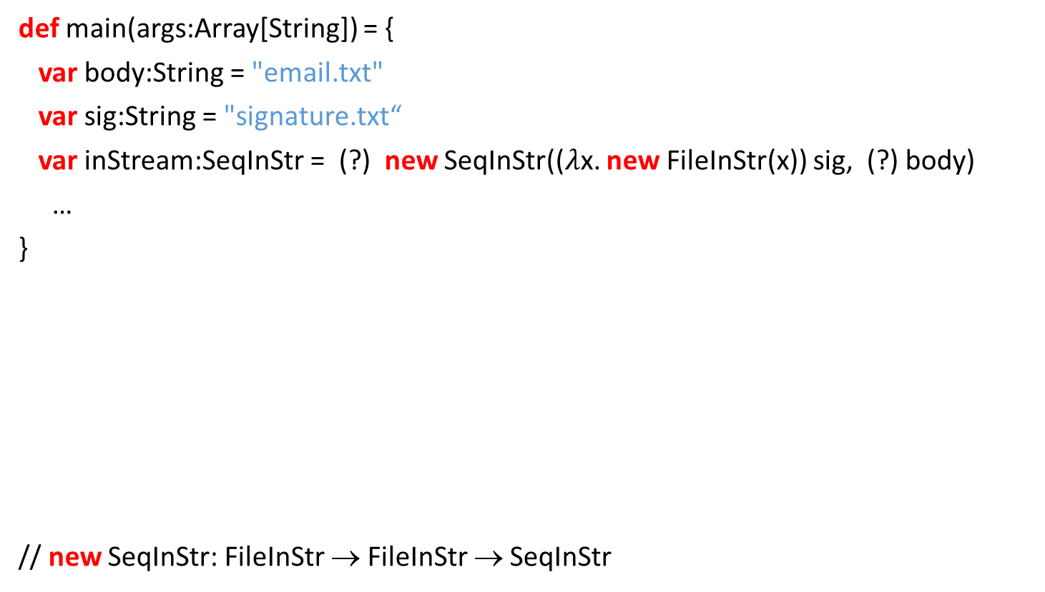
Sequence of Streams
def main(args:Array[String]) = {
var body:String = "email.txt"
var sig:String = "signature.txt“
var inStream:SeqInStr = (?) new SeqInStr(($λ$x. new FileInStr(x)) sig, (?) body)
…
}
// new SeqInStr: FileInStr → FileInStr → SeqInStr
Synthesize
Notes:
It adapt to some code base, the declarations that are more used will appear more often in the suggestions.
- Full expressions, not only a single method.
Synthesizing expressions that haven’t seen before anywhere, and are still likely to appear.

Slide 53
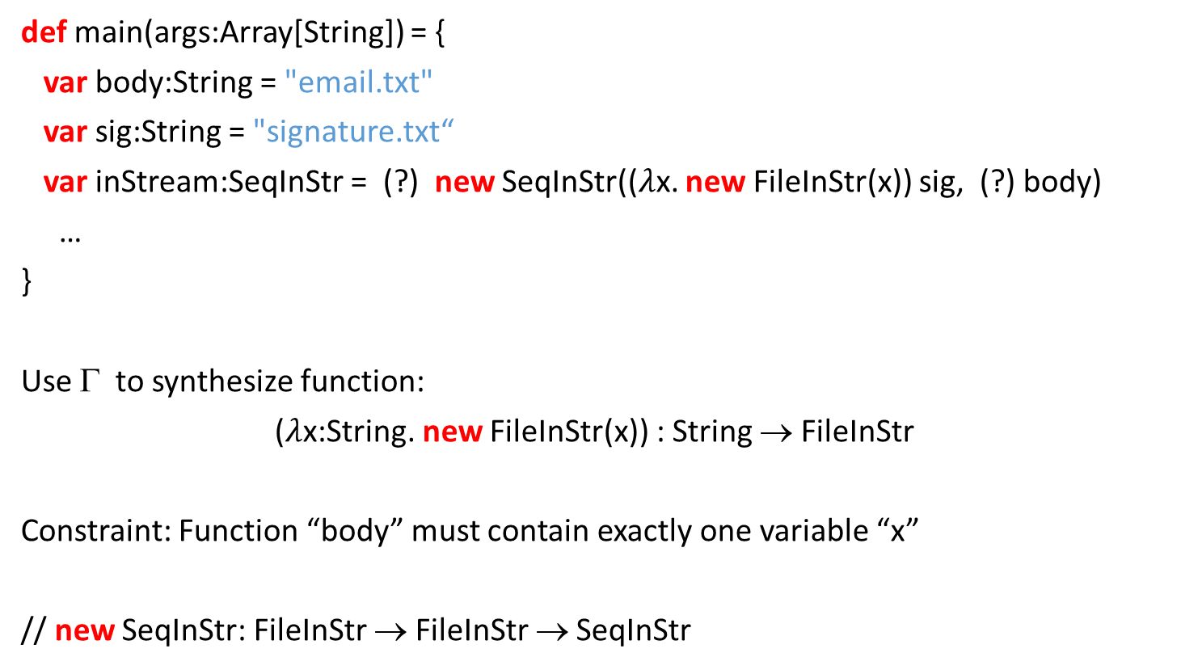
Sequence of Streams
def main(args:Array[String]) = {
var body:String = "email.txt"
var sig:String = "signature.txt“
var inStream:SeqInStr = (?) new SeqInStr(($λ$x. new FileInStr(x)) sig, (?) body)
…
}
Use Γ to synthesize function:
($λ$x:String. new FileInStr(x)) : String → FileInStr
Constraint: Function “body” must contain exactly one variable “x”
// new SeqInStr: FileInStr → FileInStr → SeqInStr
Notes:
It adapt to some code base, the declarations that are more used will appear more often in the suggestions.
- Full expressions, not only a single method.
Synthesizing expressions that haven’t seen before anywhere, and are still likely to appear.

Slide 54
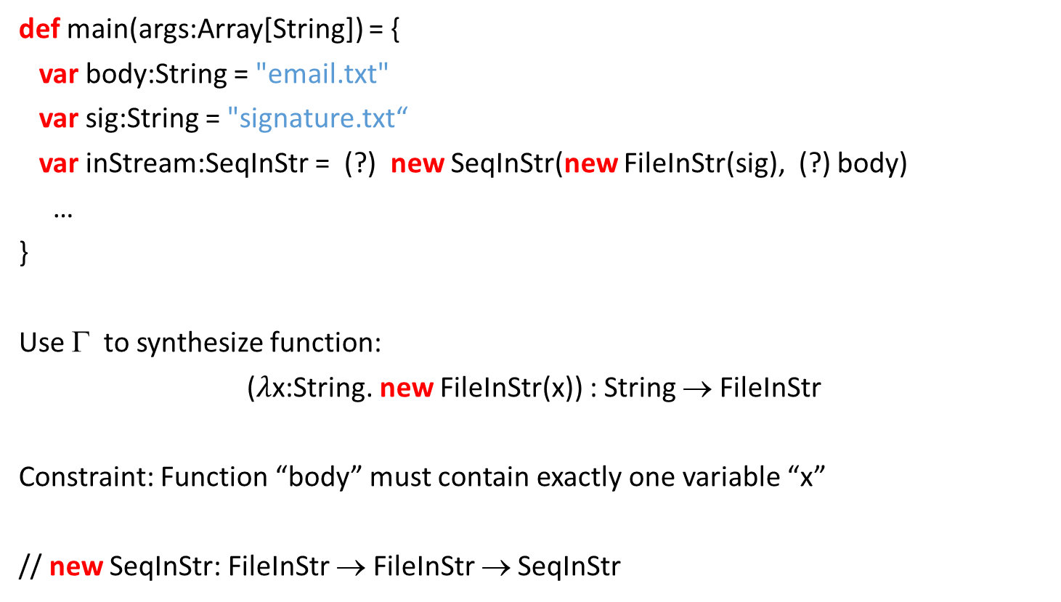
Sequence of Streams
def main(args:Array[String]) = {
var body:String = "email.txt"
var sig:String = "signature.txt“
var inStream:SeqInStr = (?) new SeqInStr(new FileInStr(sig), (?) body)
…
}
Use Γ to synthesize function:
($λ$x:String. new FileInStr(x)) : String → FileInStr
Constraint: Function “body” must contain exactly one variable “x”
// new SeqInStr: FileInStr → FileInStr → SeqInStr
Notes:
It adapt to some code base, the declarations that are more used will appear more often in the suggestions.
- Full expressions, not only a single method.
Synthesizing expressions that haven’t seen before anywhere, and are still likely to appear.

Slide 55
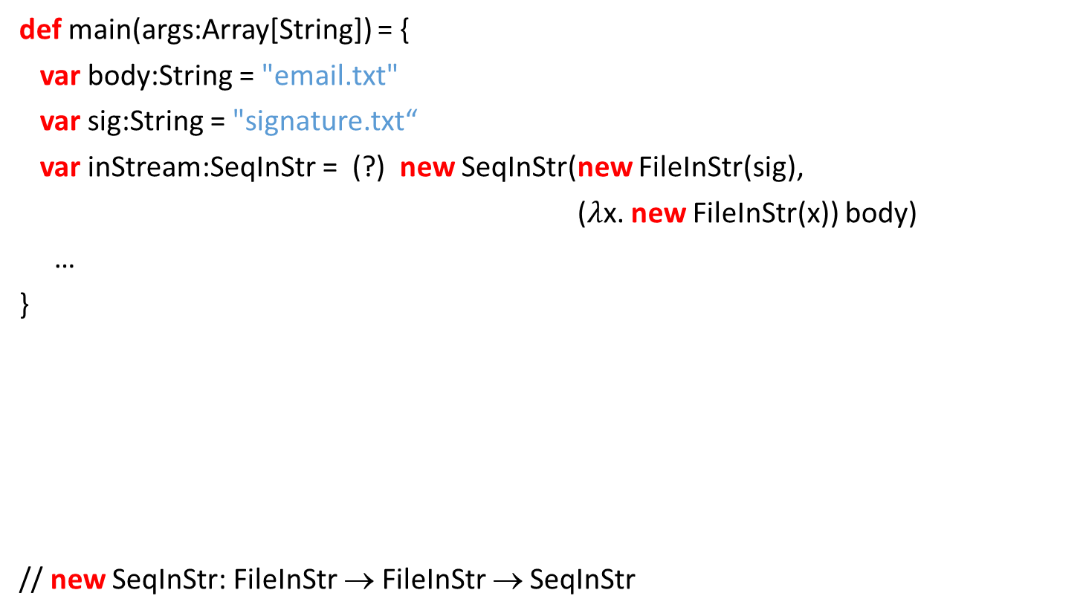
Sequence of Streams
def main(args:Array[String]) = {
var body:String = "email.txt"
var sig:String = "signature.txt“
var inStream:SeqInStr = (?) new SeqInStr(new FileInStr(sig),
($λ$x. new FileInStr(x)) body)
…
}
// new SeqInStr: FileInStr → FileInStr → SeqInStr
Notes:
It adapt to some code base, the declarations that are more used will appear more often in the suggestions.
- Full expressions, not only a single method.
Synthesizing expressions that haven’t seen before anywhere, and are still likely to appear.

Slide 56
Sequence of Streams
def main(args:Array[String]) = {
var body:String = "email.txt"
var sig:String = "signature.txt"
var inStream:SeqInStr = (?) new SeqInStr(new FileInStr(sig), new FileInStr(body))
…
}
// new SeqInStr: FileInStr → FileInStr → SeqInStr
Notes:
It adapt to some code base, the declarations that are more used will appear more often in the suggestions.
- Full expressions, not only a single method.
Synthesizing expressions that haven’t seen before anywhere, and are still likely to appear.

Slide 57
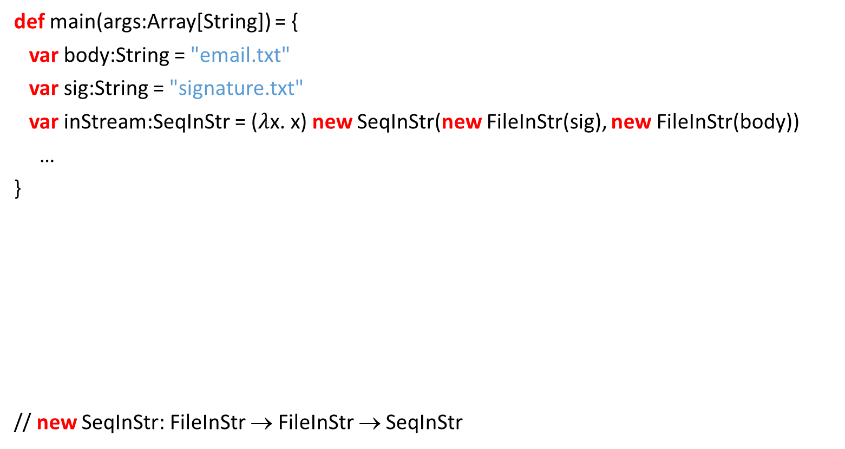
Sequence of Streams
def main(args:Array[String]) = {
var body:String = "email.txt"
var sig:String = "signature.txt"
var inStream:SeqInStr = ($λ$x. x) new SeqInStr(new FileInStr(sig), new FileInStr(body))
…
}
// new SeqInStr: FileInStr → FileInStr → SeqInStr
Notes:
It adapt to some code base, the declarations that are more used will appear more often in the suggestions.
- Full expressions, not only a single method.
Synthesizing expressions that haven’t seen before anywhere, and are still likely to appear.

Slide 58
Sequence of Streams
def main(args:Array[String]) = {
var body:String = "email.txt"
var sig:String = "signature.txt"
var inStream:SeqInStr = new SeqInStr(new FileInStr(sig), new FileInStr(body))
…
}
// new SeqInStr: FileInStr → FileInStr → SeqInStr
Notes:
It adapt to some code base, the declarations that are more used will appear more often in the suggestions.
- Full expressions, not only a single method.
Synthesizing expressions that haven’t seen before anywhere, and are still likely to appear.

Slide 59
Byte Array Stream
def main(args:Array[String]) = {
var off:Int = 8
var len:Int = 512
var size:Int = 1024
var b:Array[Byte] = args(0).getBytes()
var inStream:ByteArrayInStr = b
…
}
Notes:
It adapt to some code base, the declarations that are more used will appear more often in the suggestions.
- Full expressions, not only a single method.
Synthesizing expressions that haven’t seen before anywhere, and are still likely to appear.

Slide 60
Byte Array Stream
def main(args:Array[String]) = {
var off:Int = 8
var len:Int = 512
var size:Int = 1024
var b:Array[Byte] = args(0).getBytes()
var inStream:ByteArrayInStr = (?) b
…
}
Notes:
It adapt to some code base, the declarations that are more used will appear more often in the suggestions.
- Full expressions, not only a single method.
Synthesizing expressions that haven’t seen before anywhere, and are still likely to appear.

Slide 61

Byte Array Stream
def main(args:Array[String]) = {
var off:Int = 8
var len:Int = 512
var size:Int = 1024
var b:Array[Byte] = args(0).getBytes()
var inStream:ByteArrayInStr = ($λ$x. new ByteArrayInStr(x, off, len)) b
…
}
Notes:
It adapt to some code base, the declarations that are more used will appear more often in the suggestions.
- Full expressions, not only a single method.
Synthesizing expressions that haven’t seen before anywhere, and are still likely to appear.

Slide 62
Byte Array Stream
def main(args:Array[String]) = {
var off:Int = 8
var len:Int = 512
var size:Int = 1024
var b:Array[Byte] = args(0).getBytes()
var inStream:ByteArrayInStr = new ByteArrayInStr(b, off, len)
…
}
Notes:
It adapt to some code base, the declarations that are more used will appear more often in the suggestions.
- Full expressions, not only a single method.
Synthesizing expressions that haven’t seen before anywhere, and are still likely to appear.

Slide 63
Conclusion
Code Completion = Type Inhabitation
InSynth: Interactive Synthesis of Code Snippets
Eclipse plugin (part of Scala IDE EcoSystem)
Website
http://lara.epfl.ch/w/insynth
Repairing Code:
Polynomial Algorithm the finds the best solution

Slide 64
Thank you!
Notes:
Questions:
The graph construction is PSPACE complete (by Pjer)
Data representation (by Mikael)
Co(ntra)variance (by Alex) – we can not have decidable algorithm (we loose this property)

