Slide 1
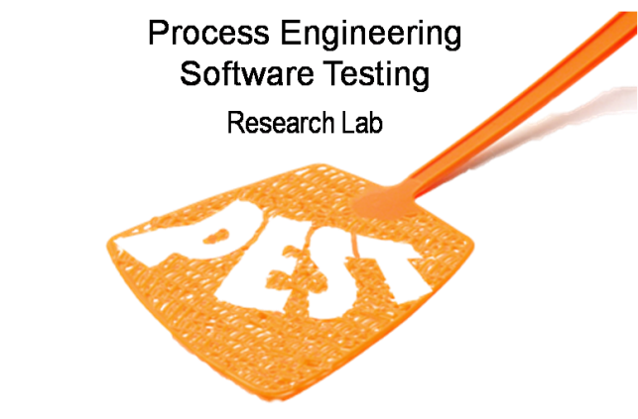
Verifying Web Applications: From Business Level Specifications to Automated Model-Based Testing
Christian Colombo,
Mark Micallef, Mark Scerri

Slide 2
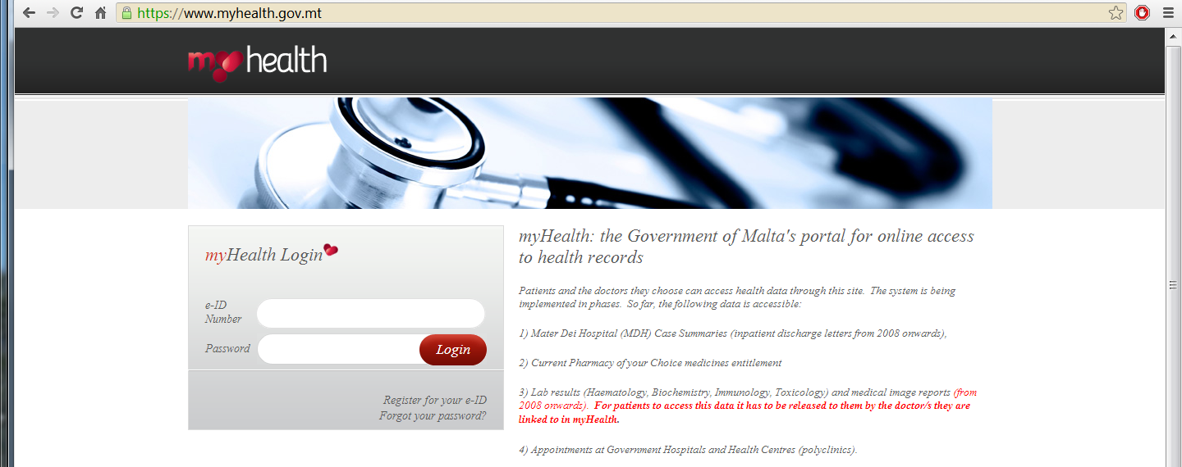
Health System

Slide 3
Verifying the Health System
Important to check implementation
(not only the model)

Slide 4
Verifying the Health System
Important to check implementation
(not only the model)
Testing and runtime verification

Slide 5
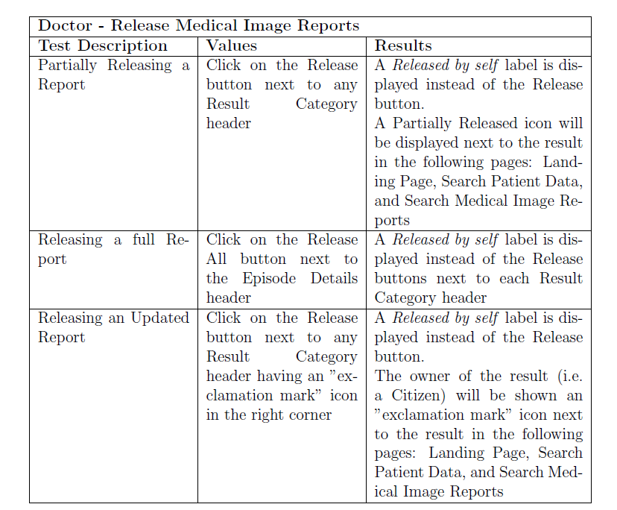
Manual Testing

Slide 6
Manual Testing
Laborious and slow!

Slide 7
Manual Testing
Laborious and slow!
Automate?

Slide 8
Automated Testing Tools
System
Executable Specification

Slide 9
Automated Testing Tools
Test Cases
System
Executable Specification

Slide 10
Automated Testing Tools
Test Cases
Oracle
System
Executable Specification

Slide 11
QuickCheck – Automated Random Testing
pre
action
post
etc
pre
action
post

Slide 12
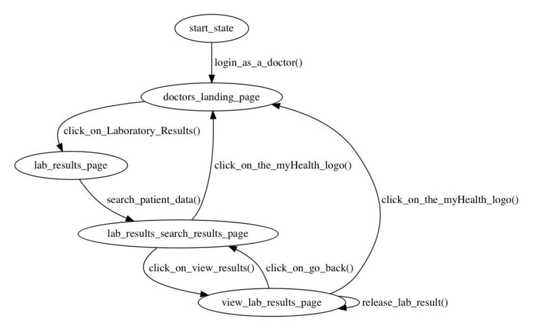
QC for Health System

Slide 13
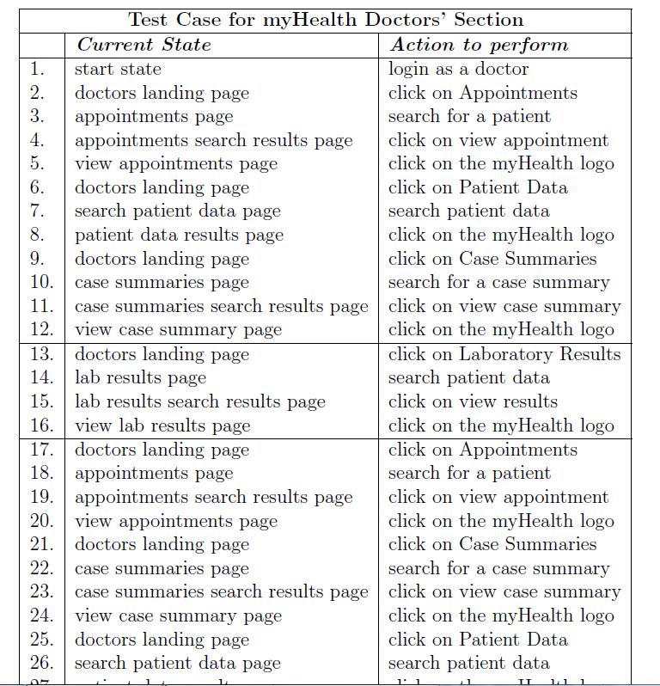
Sample Test Case

Slide 14
Connecting QC to Health System
System
Test Cases
generated by QC
Post condition check
Click
Read text area
Bridge
Executable Specification
FSM

Slide 15
Connecting QC to Health System
System
Test Cases
generated by QC
Post condition check
But where does the executable specification come from?
Bridge
Executable Specification
FSM

Slide 16
Connecting QC to Health System
System
Test Cases
generated by QC
Post condition check
But where does the executable specification come from?
How complete is the specification?
Bridge
Executable Specification
FSM

Slide 17
Standard Business Specifications
Given: ...
When: ...
Then: ...
And: ...
Given: ...
When: ...
Then: ...
And: ...
Given: ...
When: ...
Then: ...
And: ...

Slide 18
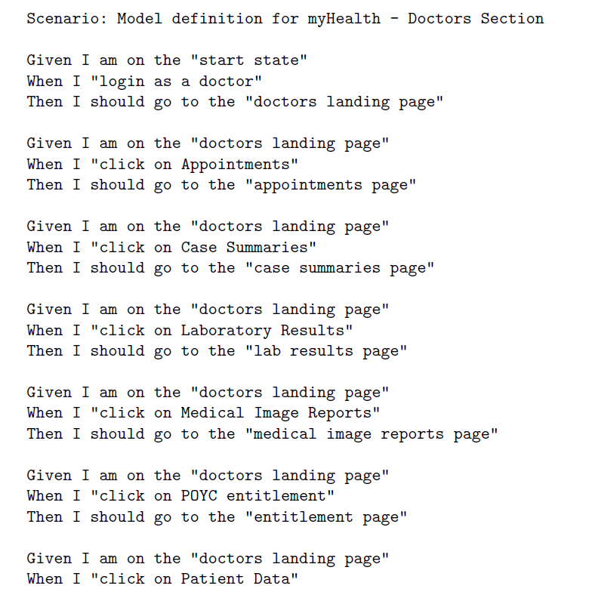
Standard Business Specifications

Slide 19
Standard Business Specifications
States

Slide 20
Standard Business Specifications
States
Actions

Slide 21
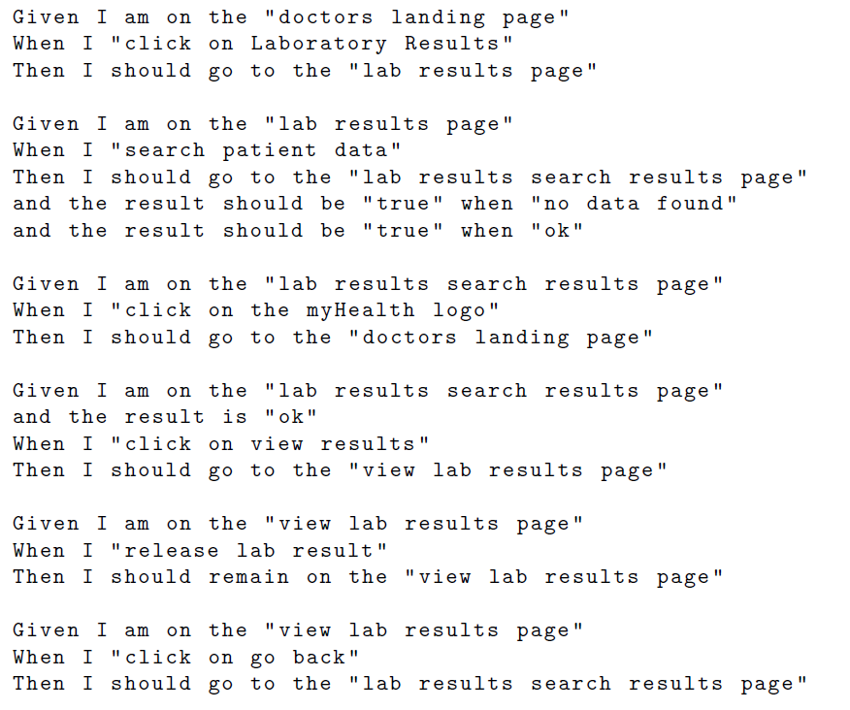
Standard Business Specifications
Post Condition
Pre Condition

Slide 22
Automatically Generated QC Model

Slide 23
Whole Process
Cucumber
QuickCheck
Model
Bridge
System

Slide 24
Results: Functionality Covered
Out of 43 function points, 39 were covered
Limitations of our language/architecture
Eg: checking a PDF, other intricate aspects
Notes:
43 function points (4 of which could not be modelled by quickcheck) 90.7%

Slide 25
Results: Test Cases
204 manual test cases
150 out of 204 created automatically
Remaining 54 could not be created due to non-covered functionality

Slide 26
Results: Time Taken (days)

Slide 27
Results: Time Taken (days)

Slide 28
Conclusions
Completely automated testing
No pain to come up with specification

Slide 29
Future Work
Testing will not cover all possibilities
Use test checks during runtime

Slide 30
Runtime Verification
Testing will not cover all possibilities
Use test checks during runtime
QuickCheck specifications can also be used for runtime verification

Slide 31
QuickCheck – Action Generation
pre
action
post
etc
pre
action
post

Slide 32
QuickCheck – Event Listeners
pre
event
post
etc
pre
event
post

Slide 33
Optimisation
Well tested...
Do not runtime verify
Keep verifying at runtime

Slide 34
Future Work
Given: ...
When: ...
Then: ...
And: ...
Given: ...
When: ...
Then: ...
And: ...
Given: ...
When: ...
Then: ...
And: ...

Slide 35
Giving Back to Business Specification World
Given: ...
When: ...
Then: ...
And: ...
Given: ...
When: ...
Then: ...
And: ...
Given: ...
When: ...
Then: ...
And: ...
Extract common checks

